Slide 1
Programming Logic
Paulo Martins

Slide 2
What’s a loop?

Slide 3
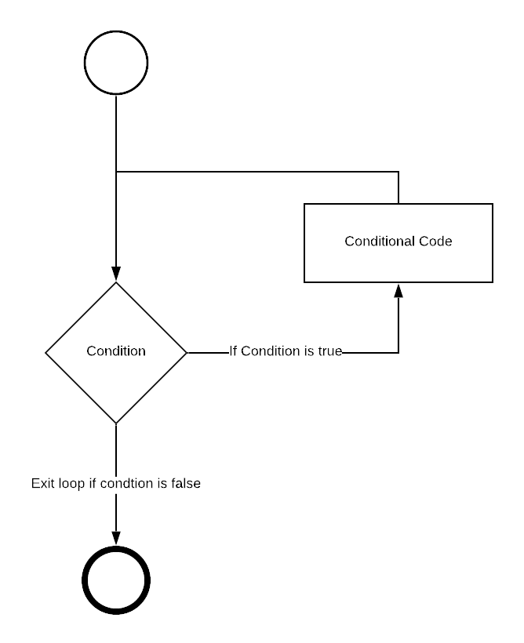
Loop Fluxogram

Slide 4
Types of Loops (according with C)
While loop
Do while loop
For loop

Slide 5
While loop
Fluxogram
X = 0;
{
Do stuff;
X = X + 1;
}
While( X not equals 5)
{
….
}

Slide 6
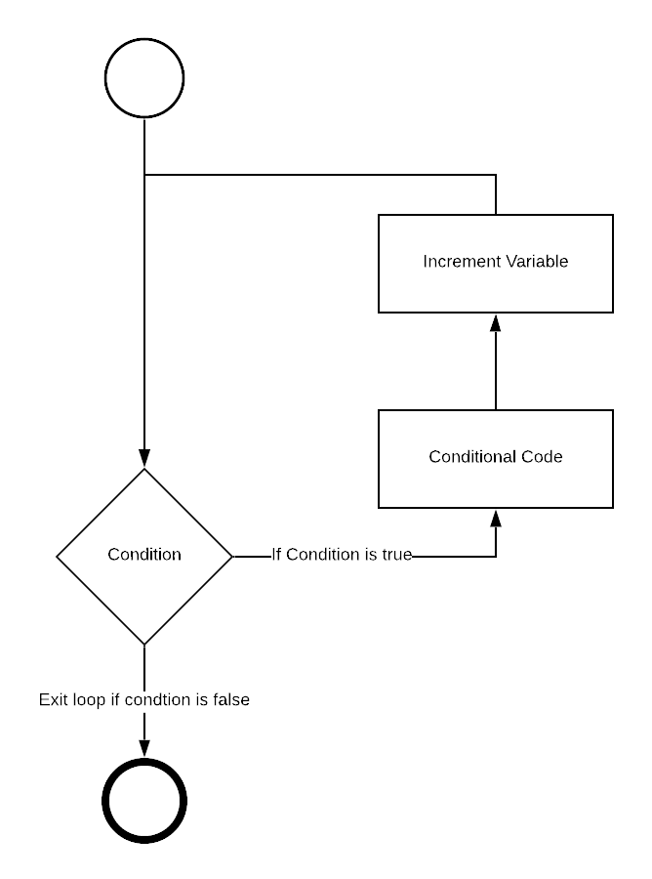
For loop
Fluxogram
For( i = 0; i lesser 5; i = i + 1)
{
…
}
{
do stuff;
}

Slide 7
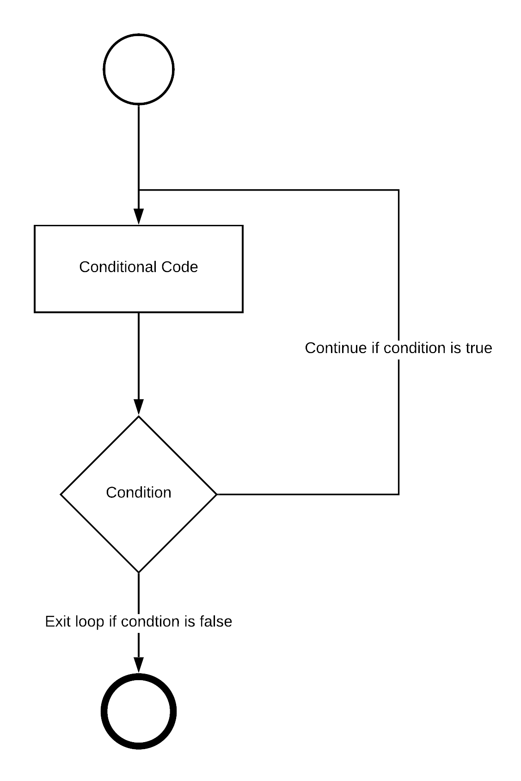
Do while loop
Fluxogram
Do
{
DO STUFF;
i = i + 1;
}
While ( i lesser then 5);

Slide 8
Object-Oriented For Each
Arrray<char> Y = [‘a’, ‘b’, ‘c’];
FOR ( char X : Y)
{
print X;
}

Slide 9
Break
Loop Instructions

Slide 10
Continue
Loop Instructions

Slide 11
Examples

Slide 12
Count to 5 using a loop

Slide 13
Int i = 0;
While( i greater then 5)
{
i ++;
}

Slide 14
Int i = 0;
While( i greater then 5)
{
i ++;
}

Slide 15
Int i = 0;
While( i lesser then 5)
{
i ++;
}

Slide 16
Int i;
for( i = 0; i lesser then 5; i++);

Slide 17
loop for ever if random number odd exit loop

Slide 18
While (true)
{
if( random() is odd)
{
continue;
}
}

Slide 19
While (true)
{
if( random() is odd)
{
continue;
}
}

Slide 20
While (true)
{
if( random() is odd)
{
break;
}
}

Slide 21
Thank You
Paulo Martins

